Slide 1

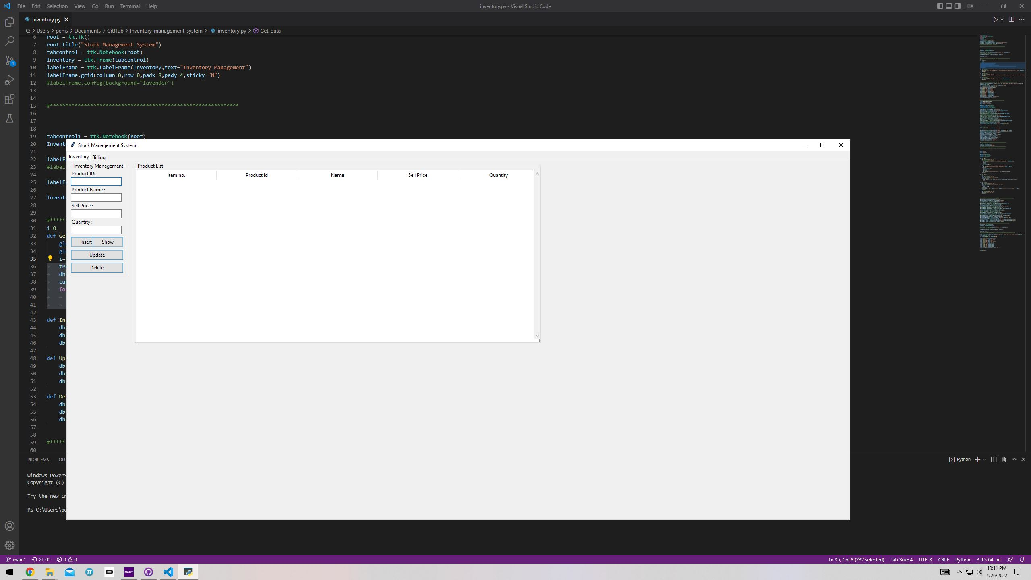
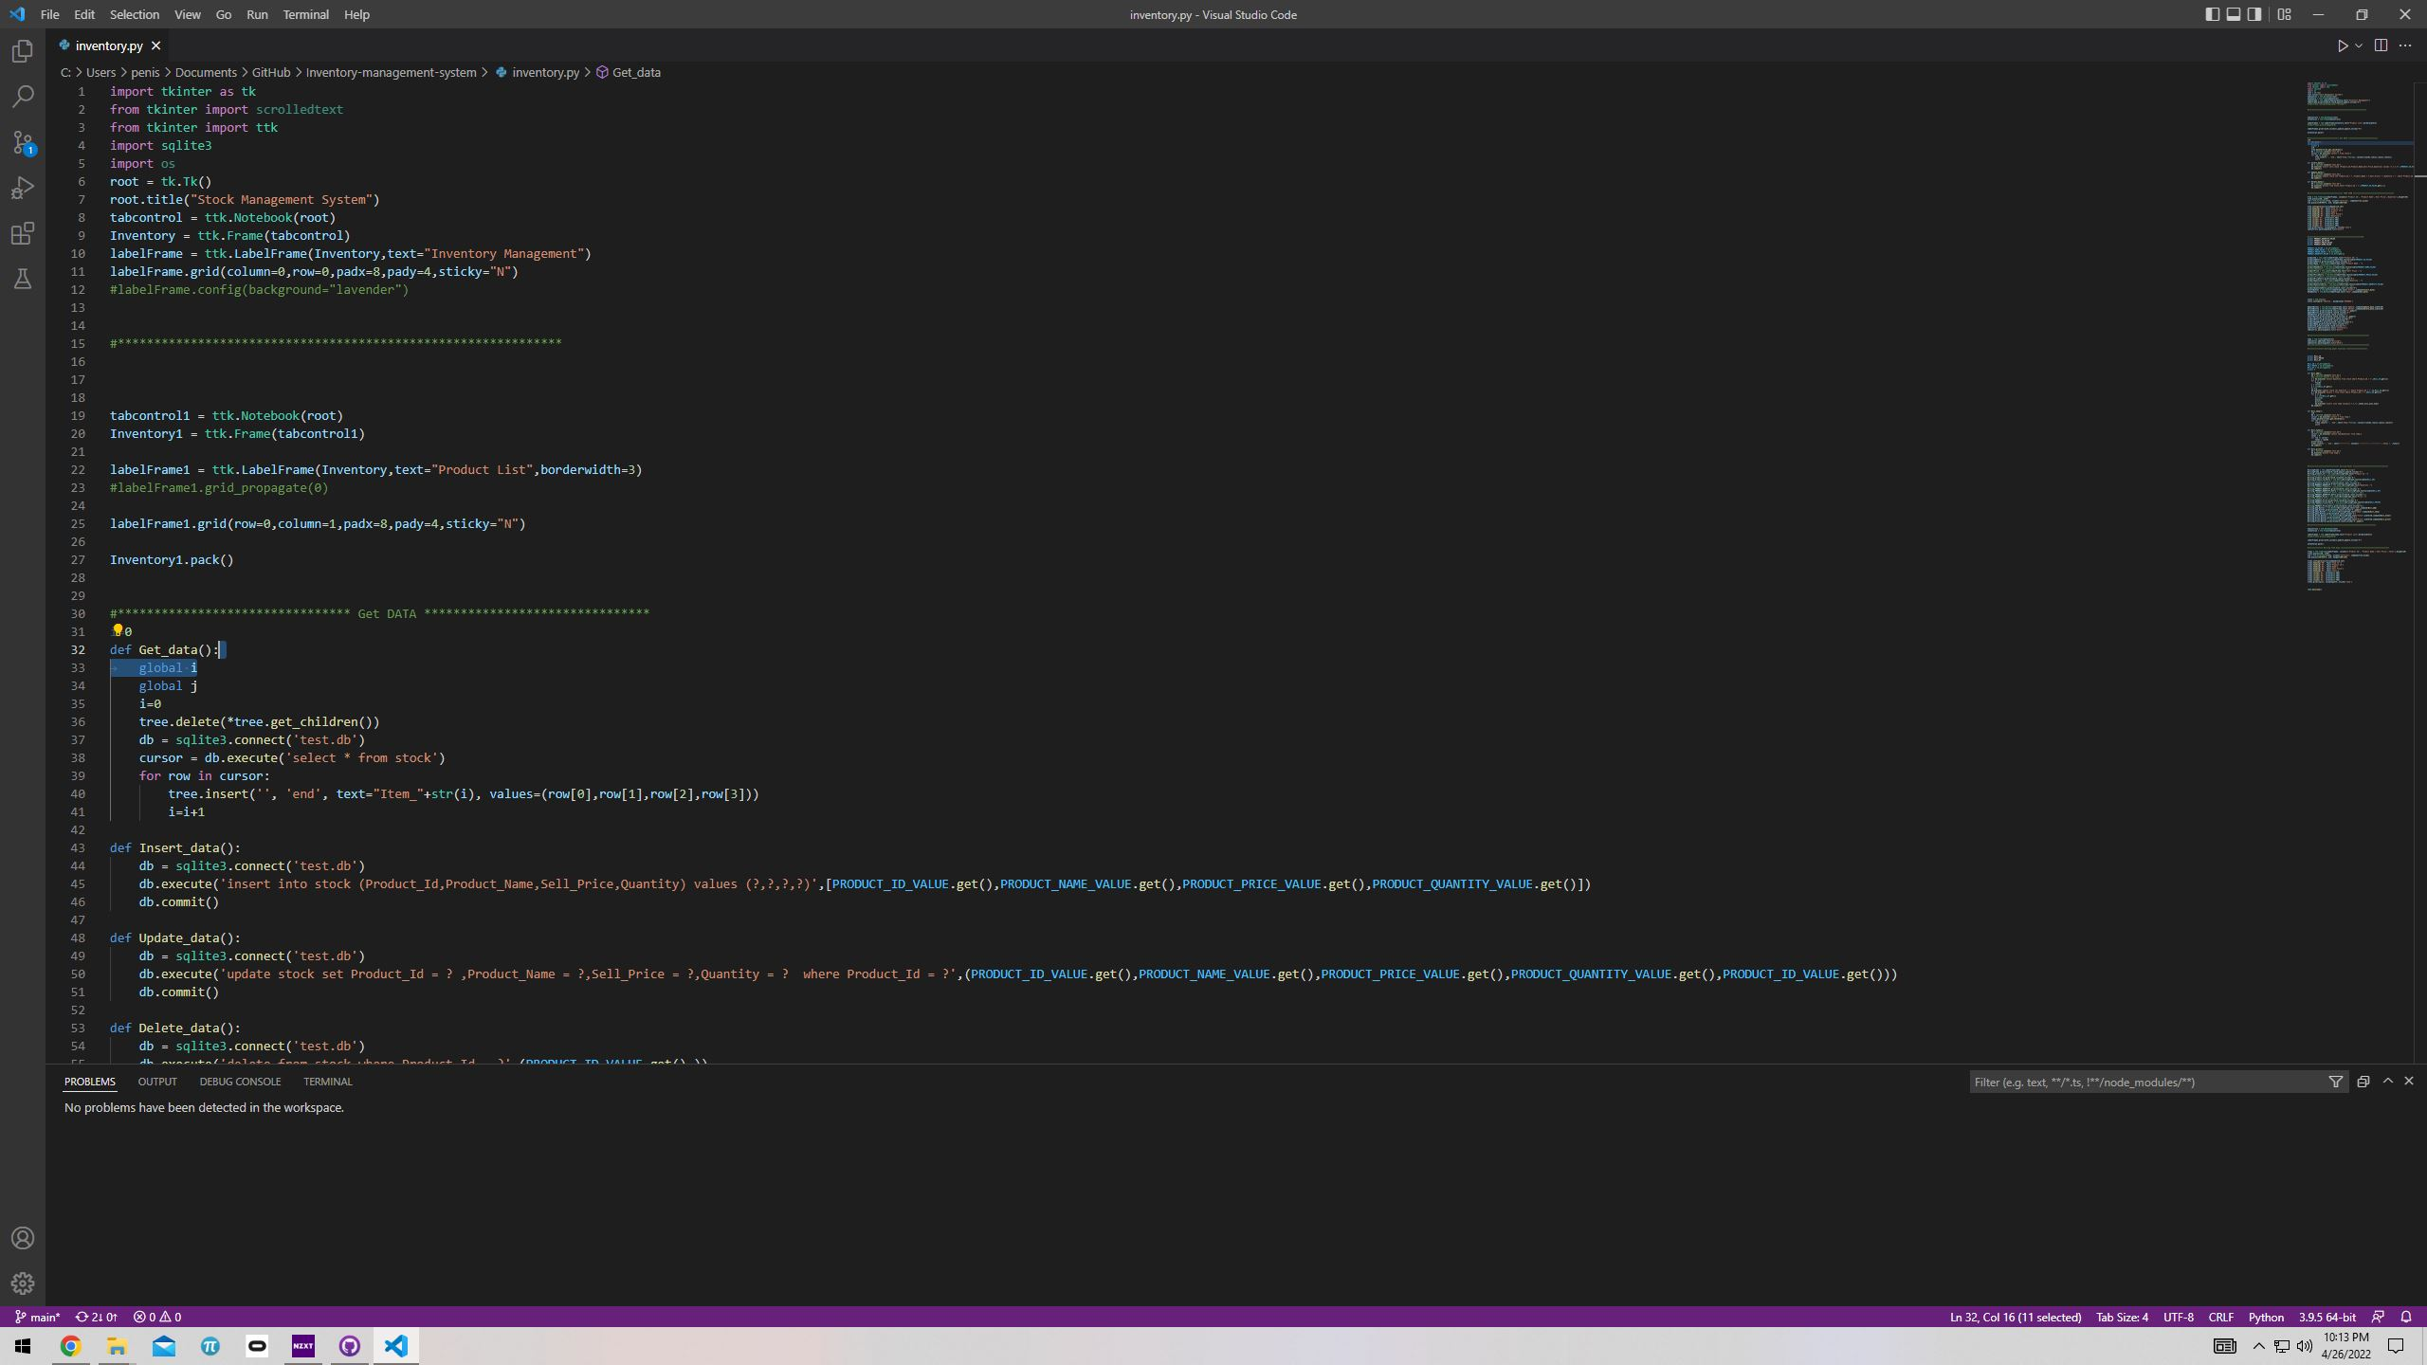
Inventory Management System
Coder: Santonu Ghosh
I am coding an app that can monitor and update the product inventory of any retail store in real time.

Slide 2
Importance of the app
Local grocery stores with low monthly budget
Small businesses
Theft control.

Slide 3
Key features
Recoding new items
Total numbers of items sold
Deducting sold items
Actual vs. Ideal inventory

Slide 4
Questions?

